Slide 1


Node.js: Revolutionizing Web Development
Node.js is a powerful JavaScript runtime environment that allows developers to build scalable network applications with ease. Its event-driven, non-blocking I/O model makes it ideal for building high-performance, real-time web applications.
작성자: 건우 이

Slide 2
Key Features of Node.js
Event-Driven
Non-Blocking I/O
Scalable
Node.js follows an event-driven architecture, allowing it to handle multiple concurrent connections efficiently.
Node.js uses a non-blocking, event-driven I/O model, making it lightweight and efficient for real-time applications.
Node.js is highly scalable, able to handle a large number of concurrent connections with ease.

Slide 3

Use Cases for Node.js
1
Web Servers
2
Real-Time Applications
Node.js is an excellent choice for building fast and scalable web servers, handling a high volume of concurrent requests.
Node.js excels in building real-time applications like chat apps, online games, and IoT platforms.
3
APIs and Microservices
Node.js is well-suited for building RESTful APIs and microservices due to its efficient handling of asynchronous tasks.

Slide 4

Benefits of Using Node.js
Faster Development
Improved Performance
Node.js allows developers to leverage the same language (JavaScript) for both client-side and server-side development, leading to increased productivity.
Node.js's non-blocking, event-driven architecture ensures high-performance and scalability, even under heavy loads.
Reduced Costs
By using a single language for the entire stack, organizations can save on development and maintenance costs.

Slide 5

Node.js for Real-Time Applications
1
Asynchronous Execution
Node.js's event-driven, non-blocking I/O model allows it to handle real-time, asynchronous tasks efficiently.
2
Scalability
Node.js can handle a large number of concurrent connections, making it suitable for building scalable real-time applications.
3
Real-Time Communication
Technologies like WebSocket, built on top of Node.js, enable real-time, bidirectional communication between clients and servers.

Slide 6




Building REST APIs with Node.js
Efficient Routing
Node.js's lightweight and modular architecture makes it easy to build scalable and maintainable REST APIs.
Asynchronous Handling
Node.js's asynchronous nature allows for efficient handling of concurrent API requests and responses.
Seamless Integration
Node.js integrates well with various databases, enabling the creation of full-stack, data-driven applications.

Slide 7




Your Experiences with Node.js
Challenges
What challenges have you faced when working with Node.js, and how did you overcome them?
Successes
What successful projects or use cases have you encountered when using Node.js?
Lessons Learned
What key lessons have you learned from your experiences with Node.js?

Slide 8
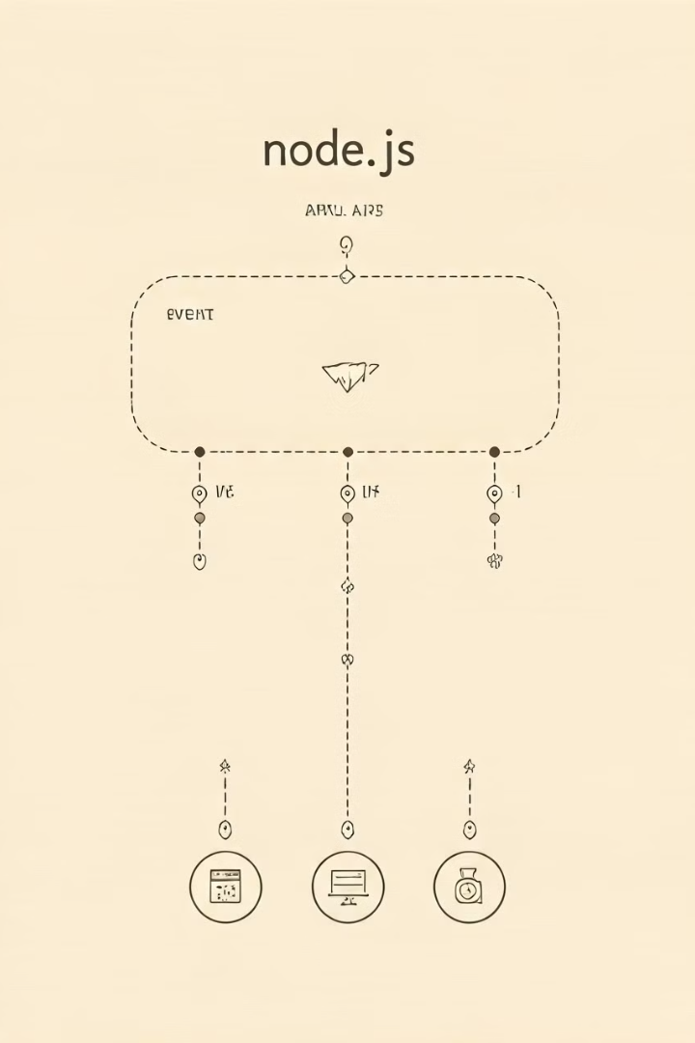
Key Takeaways
1
Scalable and Efficient
2
Versatile Use Cases
Node.js's non-blocking, event-driven architecture makes it highly scalable and efficient for building high-performance applications.
Node.js is well-suited for a wide range of applications, including web servers, real-time apps, and RESTful APIs.
3
Improved Productivity
By using a single language (JavaScript) for both client-side and server-side, Node.js enables faster development and reduced costs.

